Slide 1
From Anxiety To Action A Resilience Framework To Empower Leadership
Friday, 5th June 2020
Michael Dunlop & Alana Jones

Slide 2
AGENDA
11.00 Welcome
11:05 Where Are We Now?
11.10 What are you dealing with?
11:20 Resilience, Self Care & Self Efficacy
11.25 The Well Formed Outcome Framework
Issues to Outcomes
6 practical steps
Effective questions to take you from Anxiety to Action
11:50 Live Demonstration
Q&A
Discussion: How this framework can be applied personally & professionally
1215 Conclude
Notes:
Dealing with challenges is an inevitable part of leadership. Over time, leaders will develop a suite of support tools for the difficult times. However, the scale of the challenge the Coronavirus pandemic presents to public sector leaders is relentless, unprecedented and multifaceted, and it is all too easy to feel overwhelmed or anxious in this context.
In this webinar, Michael Dunlop and Alana Jones, OR Consultants, will present The Well Formed Outcome framework, an evidence-based, practical set of steps that can help you to develop your own resilience in dealing with these situations.
This framework is designed to take you from dealing with problems and issues to creating achievable outcomes and to bring more of the situation back within your control.
It is a very effective framework for conversations and meetings in leading and managing remote teams.
Participants will:
· Gain practical experience of a framework that they can begin to use immediately
· Learn key questions to quickly get to the heart of an issue
· Create achievable outcomes and next steps that are within their control
· Discuss and plan for how this framework can be effectively applied both personally and with teams and organisations
To attend this webinar, click on the registration button below and enter the password topcat. A link to the webinar will be emailed to you.

Slide 3
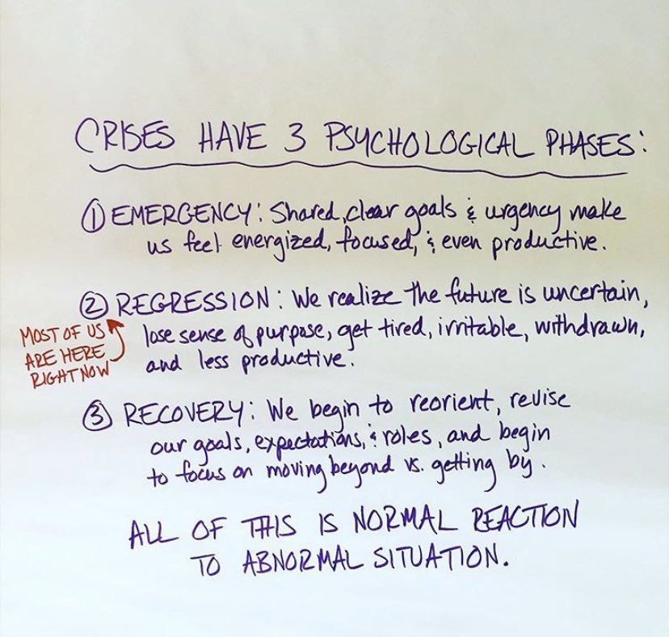

Slide 4
What issues do staff face at the moment?
Anxiety and Concern about own health
Loss of usual routines, habits and hobbies, parts of identity
New and Unknown experience
Socio-economic issues
Contact with COVID patients – Safety Concerns
Uncertainty, fear, stress, helplessness,
‘burnout’, Moral Injury or Distress
Dealing with distressed patients and families
Anxiety and concern about loved ones
Sudden changes in service structure & delivery
Strains on capacity
Loss of planned and hoped for experiences
Imposed Narratives
Disconnection from others

Slide 5
What issues do we face at the moment?
Anxiety and Concern about own health
Loss of usual routines, habits and hobbies, parts of identity
New and Unknown experience
Socio-economic issues
Contact with COVID patients – Safety Concerns
Uncertainty, fear, stress, helplessness,
‘burnout’, Moral Injury or Distress
Dealing with distressed patients and families
Anxiety and concern about loved ones
Sudden changes in service structure & delivery
Strains on capacity
Loss of planned and hoped for experiences
Imposed Narratives
Disconnection from others

Slide 6
What’s it like for you?

Slide 7
Notes:
Mood barometer – How are you feeling?
It been a tough ride – navigating our way through these past 10 weeks….when you reflect on your own high and low moments, where’s your reading?
How are you feeling? Low to Max; struggling feeling anxious all the time, hanging in there with moments of stress, managing with 50/50 – anxious moments to got it sorted; or are you experiencing a feeling of focus, calm, composed, confidence majority of the time?

Slide 10
“Would you tell me please which way I ought to go from here?” “That depends a good deal on where you want to get to,” said the cat. “I don’t much care where …” said Alice. “Then it doesn’t much matter which way you go,” said the cat.

Slide 11
Focus on what you do want!

Slide 12
To live the life you want, you need to know what you want. Being effective in the world, means producing the results you choose. The first step is to choose.”
Joseph O’Connor and John Seymour

Slide 15
Well Formed Issue
X [problem] is causing Y [pain]
How is this a problem for me?

Slide 17
What would you rather have?
Positively stated
Something you can do

Slide 19
If you could have that, would you take it?
Get to a wholehearted yes!

Slide 21
When do you want this [to start]? Where? What time?
Get specific

Slide 22
“A goal without a date is just a dream”
Milton H Erikson

Slide 23
How will you know when you have achieved your outcome?
What will you notice, see, feel, hear…?

Slide 24
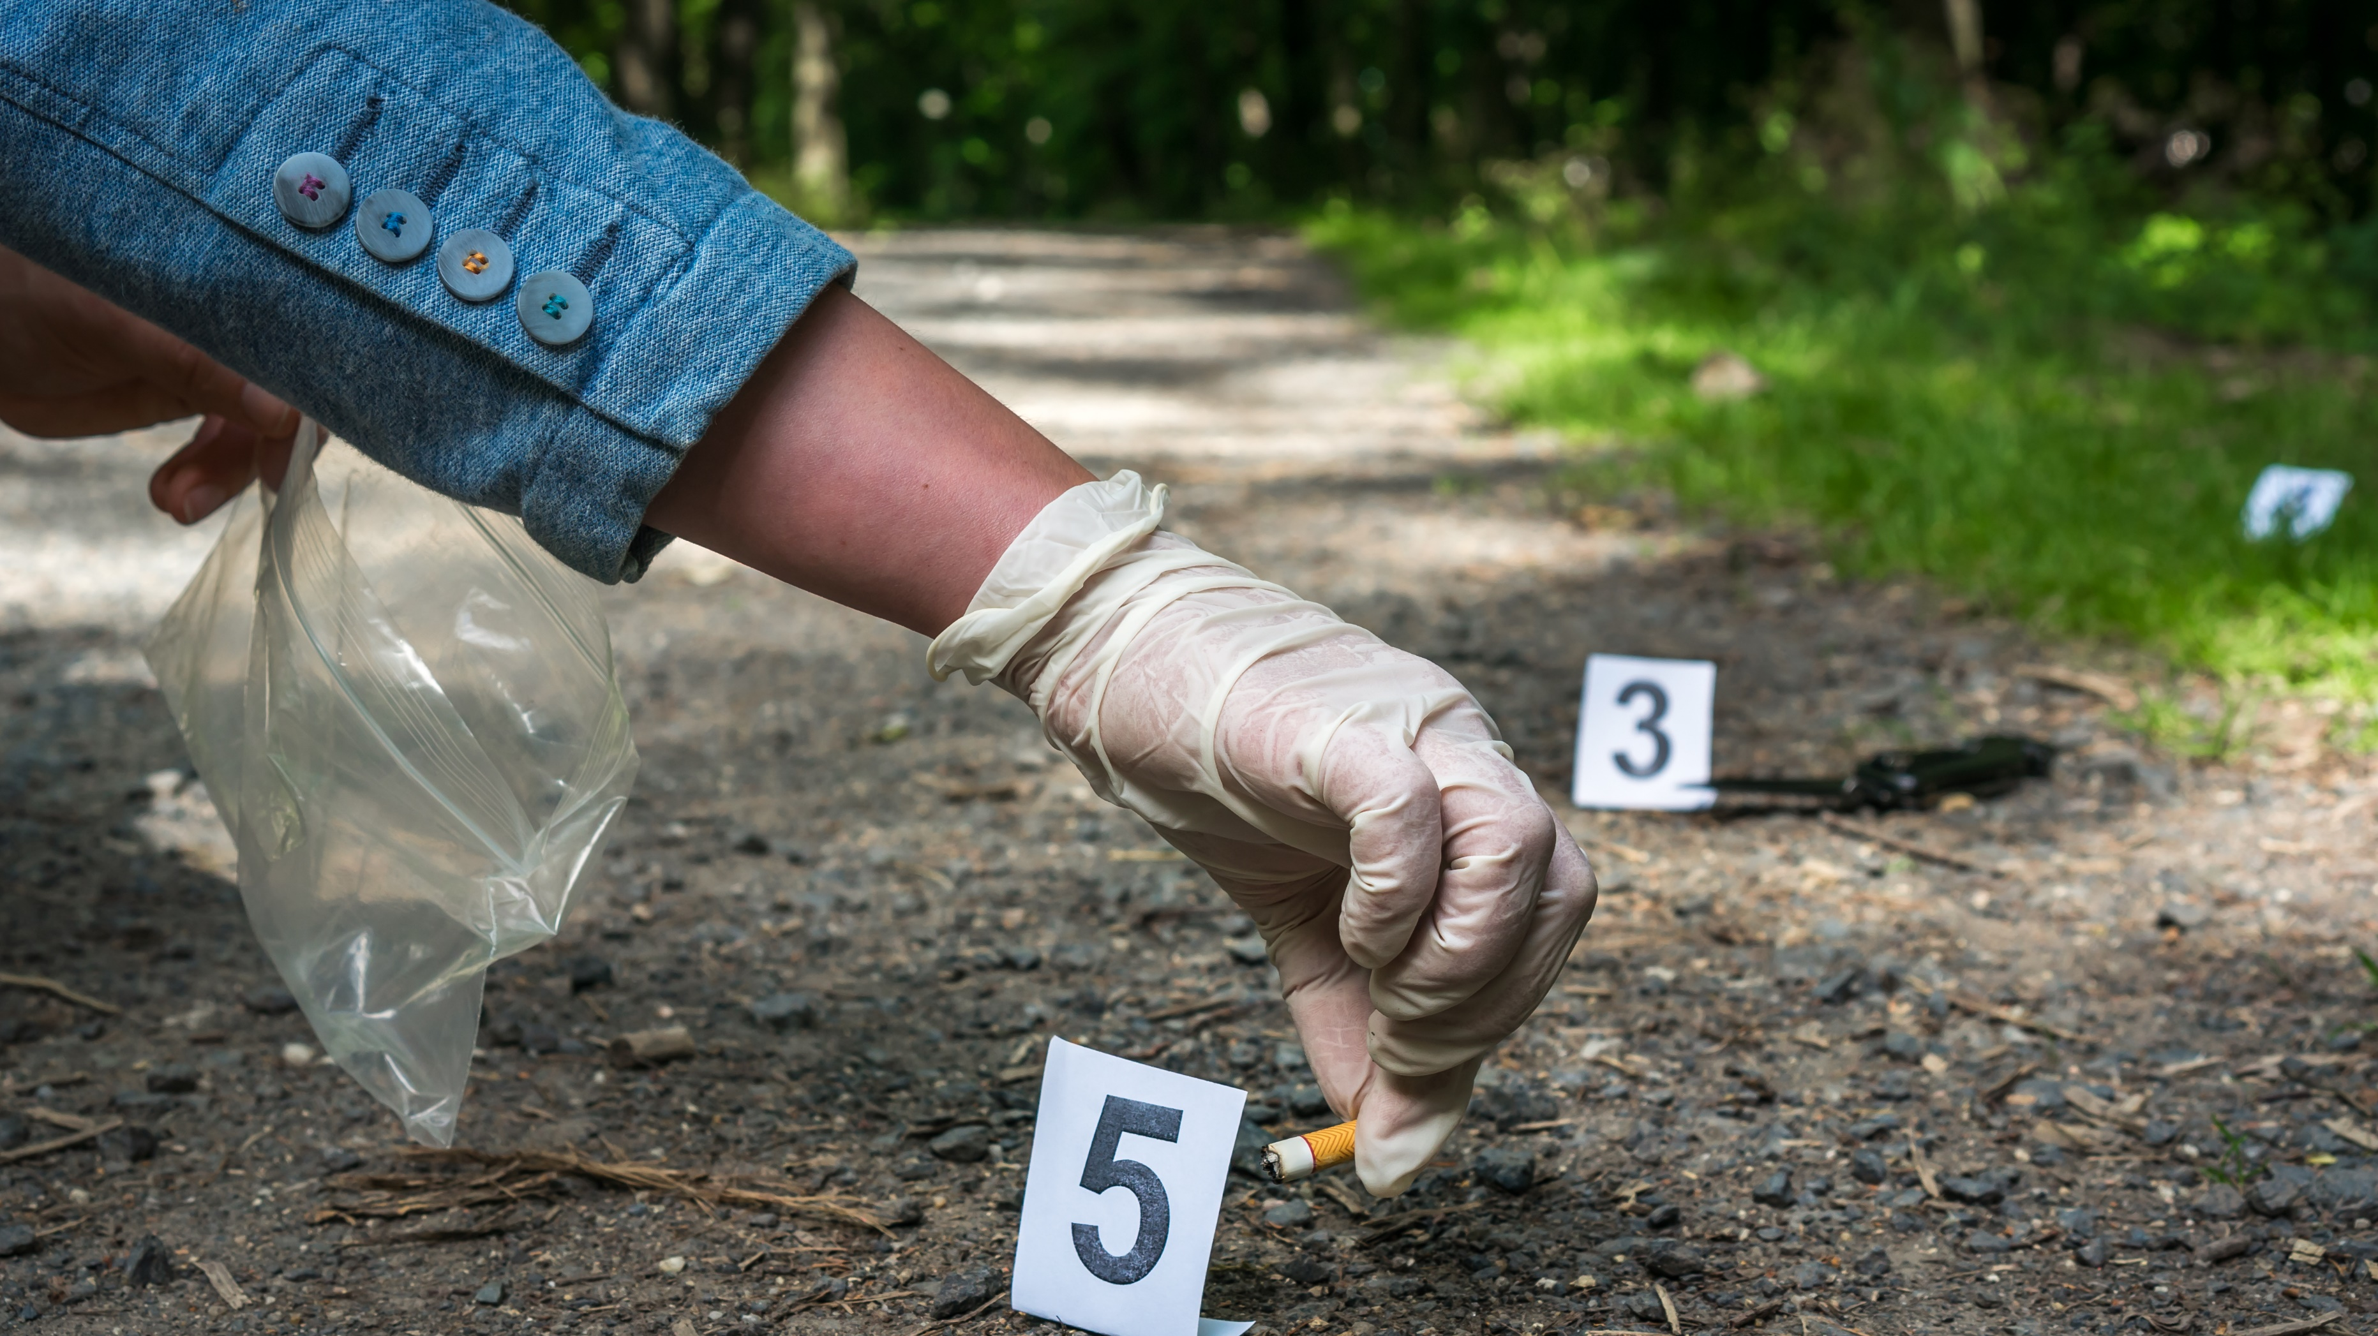

Slide 25
How much of this is within your own control?

Slide 26
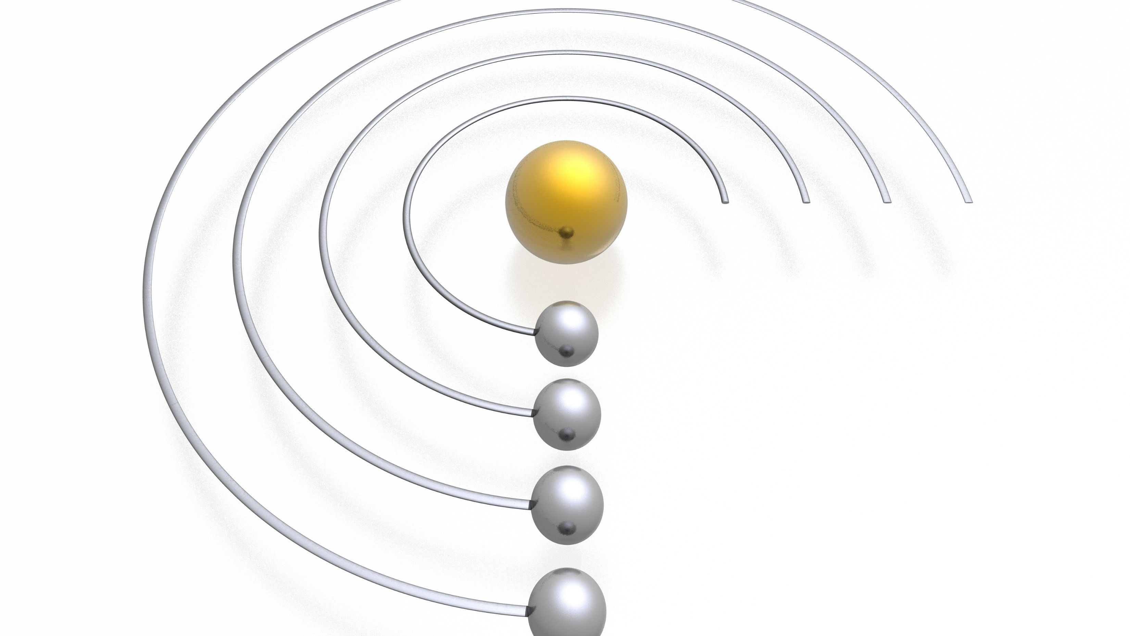

Slide 27
WFO Checklist
1. How Is This A Problem For You?
3. Ecology check
Write down what’s bothering you
Ask: ‘How is this a problem for me?’
2. State in the Positive
Think of what you want rather than what you do not want
Ask; ‘What would I rather have’ or ‘What do I want instead?’
Check the consequences in your life and relationships if you get your outcome
Ask: ‘If I could have it right now, would I take it?

Slide 28
WFO Checklist
4. Be specific about what you want
5. How will you know you’ve achieved it?
6. Is it within your control?
Ask; ‘Who, where, when, what and how specifically’
Think of the sensory based evidence that will let you know you have it.
Ask; ‘How will I know I have it? What will I see, hear and feel?’
Think of what you will do, what is in your control?
Ask; ‘What will I do to achieve my outcome’

Slide 30
©2020 OR Training & Personal Development Ltd
For Further Information Please Contact:
OR Training & Personal Development Ltd
Tel: 07833230136
Email: michael@liveitorleadit.com
Web: www.liveitorleadit.com

Slide 31
Thank you
Michael Dunlop
Tel: 07833230136
Web: www.liveitorleadit.com
Alana Jones
Tel: 07880504887
Web: https:\\alanajones.co.uk
www.linkedin.com/in/michael-dunlop-nlp
www.linkedin.com/in/alana-jones-coach
michael@liveitorleadit.com
wps@alanajones.co.uk
Notes:
AS HAVE MORE QUESTION OR WANT TO TALK ABOUT SOMETHING IN PARTICULAR – HANGING AROUND STRAIGHT AFTER THIS, IF I CAN ANSWER OR HELP ANYONE.
HOW TO CONTAT EITHER OF US IS: -
MICHAEL - OR LOGO – WEBSITE / EMAIL
ALANA – CONTACTS
WE HAVE THIS: -
CEF - COACHING CONVERSATION FOR LEADERS – FREE 1 HOUR SESSION. COULD WE HAVE AN IMAGE OF FLYER FROM ANNE AND THAT AS A FULL SLIDE?
NEXT PROGRAMME
THANK YOU

