Slide 1
Planning For The Future In An Uncertain World
Thursday, 18th June 2020
Michael Dunlop
Lynn McKeown

Slide 2
AGENDA
Introductions
Setting the scene
Uncertainty & Ambiguity to Creativity & Clarity
The Hero’s Journey
Logical Levels Concept
1125 Experience this framework
1145 Your purpose / Your why / Now
Re-creating your plan & diagnose issues
1210 Questions & Discussion

Slide 3
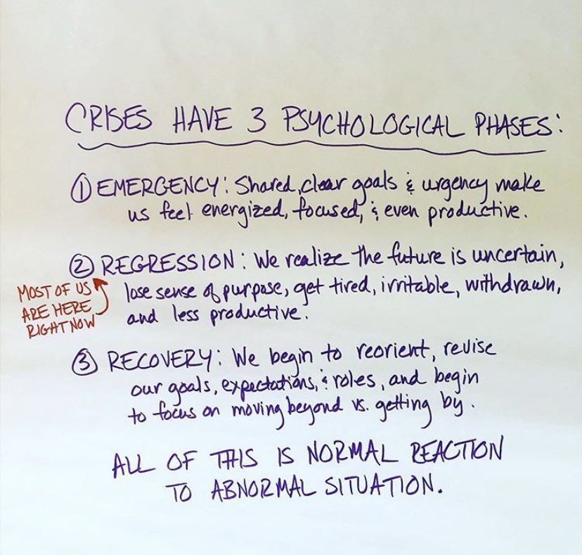
CRISES HAVE 3 PSYCHOLOGICAL PHASES

Slide 4
What issues do staff face at the moment?
Anxiety and Concern about own health
Loss of usual routines, habits and hobbies, parts of identity
New and Unknown experience
Socio-economic issues
Contact with COVID patients – Safety Concerns
Uncertainty, fear, stress, helplessness,
‘burnout’, Moral Injury or Distress
Dealing with distressed patients and families
Anxiety and concern about loved ones
Sudden changes in service structure & delivery
Strains on capacity
Loss of planned and hoped for experiences
Imposed Narratives
Disconnection from others

Slide 5
What issues do we face at the moment?
Anxiety and Concern about own health
Loss of usual routines, habits and hobbies, parts of identity
New and Unknown experience
Socio-economic issues
Contact with COVID patients – Safety Concerns
Uncertainty, fear, stress, helplessness,
‘burnout’, Moral Injury or Distress
Dealing with distressed patients and families
Anxiety and concern about loved ones
Sudden changes in service structure & delivery
Strains on capacity
Loss of planned and hoped for experiences
Imposed Narratives
Disconnection from others

Slide 8
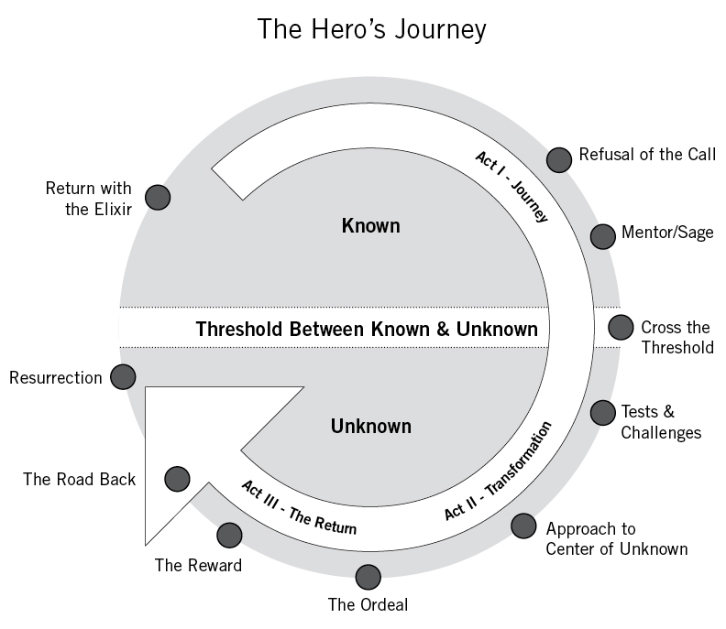
‘We must be willing to let go of the life we have planned so as to accept the life that is waiting for us’ Joseph Campbell

Slide 9
Control what we have the choice to control
Uncertain | Certain | The power of choice
How long this will last? The impact to country? How long, how deep the economic crisis lasts? Budgets? | Things will be different Skills Talent Processes Connections Opportunities | What I can do What I can focus on How I can plan How I can lead my team My actions Our actions

Slide 10
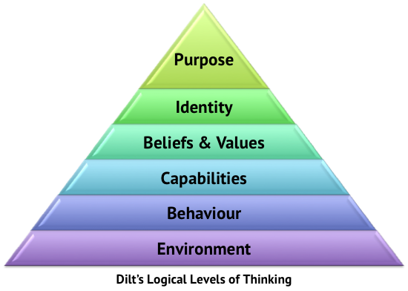
Logical Levels Of Leadership
With Thanks To Robert Dilts

Slide 11
For What / Who Else?
Who?
Why? What’s Important?
How?
What?
Where? When?

Slide 12
Logical Levels | Past | Future | Logical Levels
Purpose |  |  | Purpose
Identity |  |  | Identity
Beliefs |  |  | Beliefs
Skills / Capabilities |  |  | Skills / Capabilities
Behaviours |  |  | Behaviours
Environment |  |  | Environment

Slide 13
Re-emerge stronger, better

Slide 14
Project Planning…….
What do I want to have happen? Outcome……. | Really? | When? Where? | How will I know? | How much of this is within my control? What is / what’s not?
Project 1 |  |  | 1. 2. 3.
Project 2
Project 3

Slide 15
A Point In The Future…………..

Slide 16
What’s Next…..
Logical Levels Template – Try it out – Imagine the ideal
Be honest – what’s holding you back
Reach out and use a coach to build this up and help you
Stay fit, healthy and well

Slide 18
©2020 OR Training & Personal Development Ltd
For Further Information Please Contact:
OR Training & Personal Development Ltd
Tel: 07833230136
Email: michael@liveitorleadit.com
Web: www.liveitorleadit.com

Slide 19
Thank you
Michael Dunlop
Tel: 07833230136
Web: www.liveitorleadit.com
Lynn McKeown
Tel: 07961769776
www.linkedin.com/in/michael-dunlop-nlp
www.linkedin.com/in/lynn-mckeown-leadership-coach
michael@liveitorleadit.com
lynnmckeown2009@gmail.com

