Slide 1



Slide 2


Slide 3
2000 200
Participants supported
Participants into jobs
Excellent Participant Experience
1000
Participants that gained qualitifactions
85%
Participants still in jobs after 6 months

Slide 4
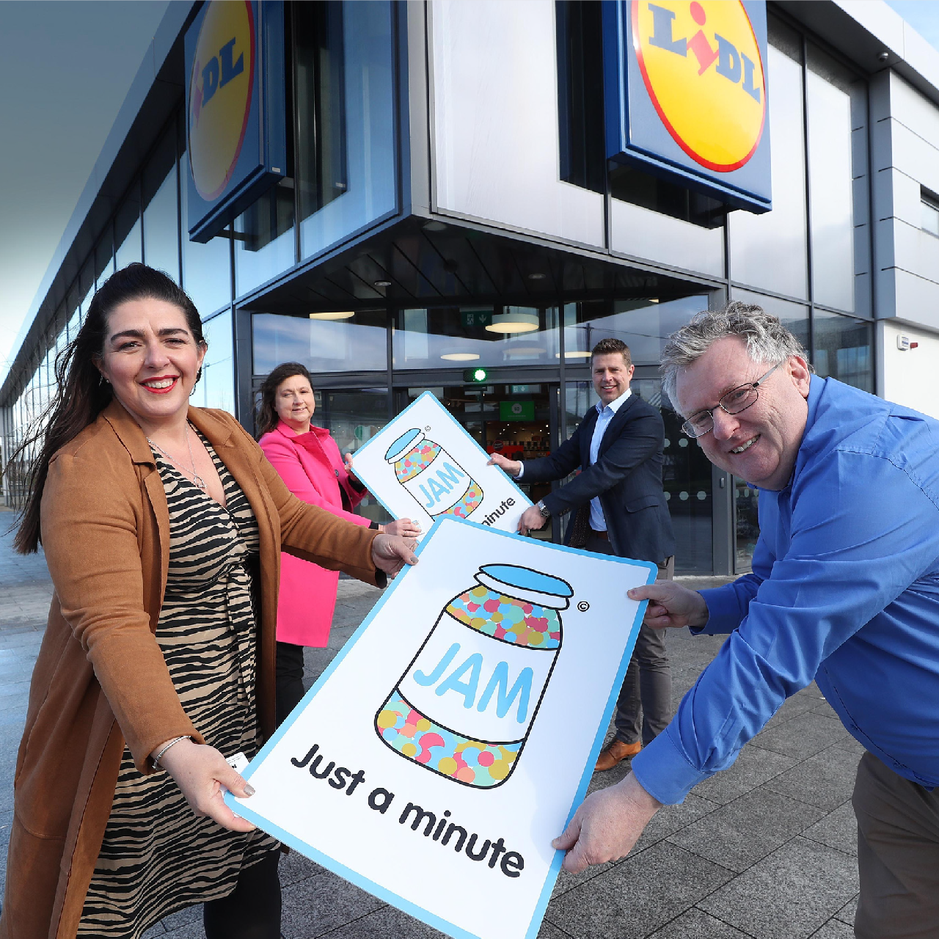
JAM Card© Partner
As a first step becoming a JAM Card© Partner provides you with the expertise to continually review your existing service, whilst developing and implementing new practices to address communication barriers.
We provide expert guidance and advice alongside tailored training to support you with your inclusion strategy.
www.jamcard.org

Slide 5
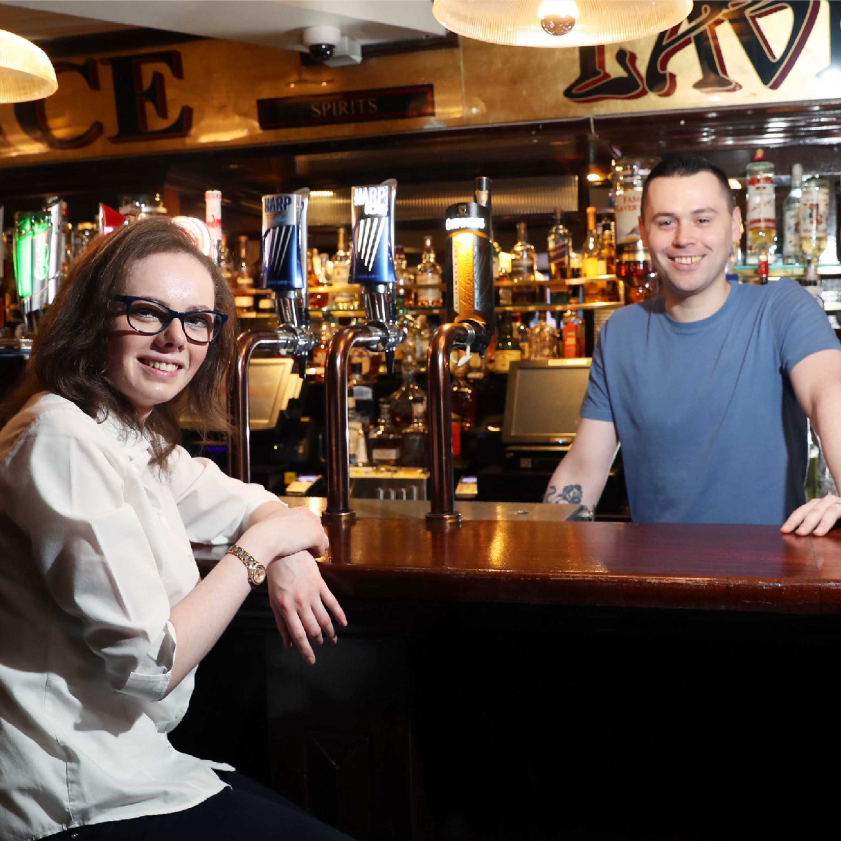
Jobs With a Future
We support participants across a range of jobs and sectors and deliver accredited academy training programmes in catering, hospitality, warehousing, retail and data analytics, cyber security and digital administration.
We work with leading businesses across industry to fill multiple vacancies and provide ongoing support to the employer and successful candidates.
www.nowgroup.org

Slide 6

Supply Chain Partner
We operate a range of social businesses including Loaf Catering and Loaf Pottery We are keen to partner with businesses and get into their supply chain. We already provide corporate catering and handmade giftware to companies across the island of Ireland.
www.loafcatering.com

Slide 7
Social value scoring is starting conversations
Still quite easy to tick the boxes.
What next?
Sustainability needs lasting partnerships
Social enterprise sector needs investment

Slide 8
Tel: 028 9043 6400
twitter.com/@NOW_Group
facebook.com/nowgrouporg www.nowgroup.org

